Slide 1
Innovation at Anthem
An overview of our innovation approach, team and process
Learning & Development Team
January 12, 2016

Slide 2
Our innovation goals

Slide 3



What does innovation mean at Anthem?
The creation of viable new offerings and capabilities that will help us optimize and grow our business.

Slide 4
Our innovation goals
1
2
3
Have Anthem be recognized as the most effective innovator in the industry
Align our innovation efforts across the enterprise
Improve our innovation portfolio so it provides a better return

Slide 5




How are we growing innovation at Anthem?
Q1
Q2
Q3
Q4
Establishing innovation function
Generating innovative ideas
Deliver innovation solutions
Socialize innovation capability
Notes:
This slide is final
Family Health History
Office Visit Journey
Get Help Journey
Welcome Journey
Pay My Bills Journey
cFHR/Apple Watch
Boyd Member Dashboard
Natural Language benefits search
Medical Policy Alerts
Episode of Care Advisory
Crowd Sourced Application Testing
Population Health Management

Slide 6
Our approach to innovation

Slide 7



We have everything you need to innovate
+
+
Place
Collaborative facility with ready-to-use technology
People
Multi-disciplinary
team of innovation experts
Process
Agile process with defined funding pool and governance model

Slide 8
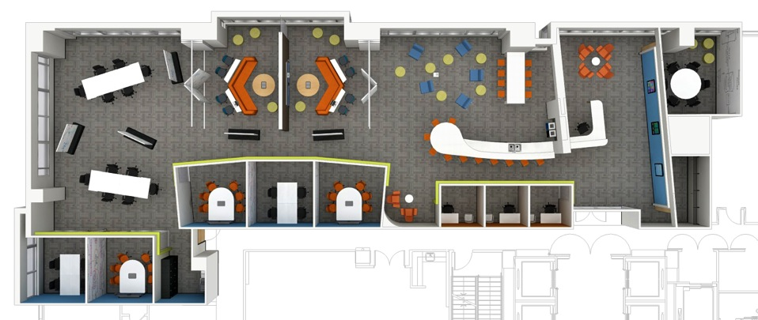
The Innovation Studio and its team are located in Atlanta
Collaboration/Work Zone A
Collaboration/Work Zone C
Collaboration/Work Zone D
Coffee/Group Collaboration
Waiting
Collaboration
Interactive Gallery
Collaboration/Work Zone B
Studio 3
Studio 2
Studio 1
Private Zone
Entry
Luggage
Studio 5
Studio 4
Print/Copy
Innovation Studio space plan

Slide 9
The Innovation Studio facility was built for collaboration
Configurable an environment
Provides project teams with space flexibility and creativity
Dedicated project studios
Include innovative technologies to help speed projects
Collaboration work zones Encourage sharing of best practices and lessons-learned across projects

Slide 10
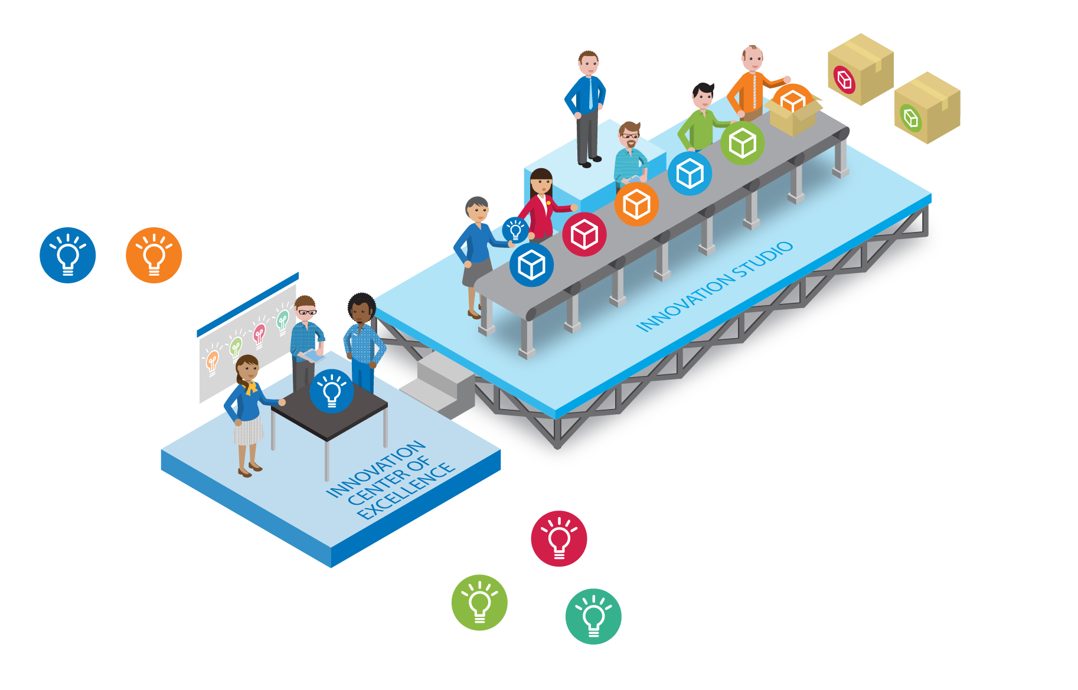
We have a multi-disciplinary innovation team
Helps stimulate, facilitate and support innovation efforts across the enterprise.

Slide 11
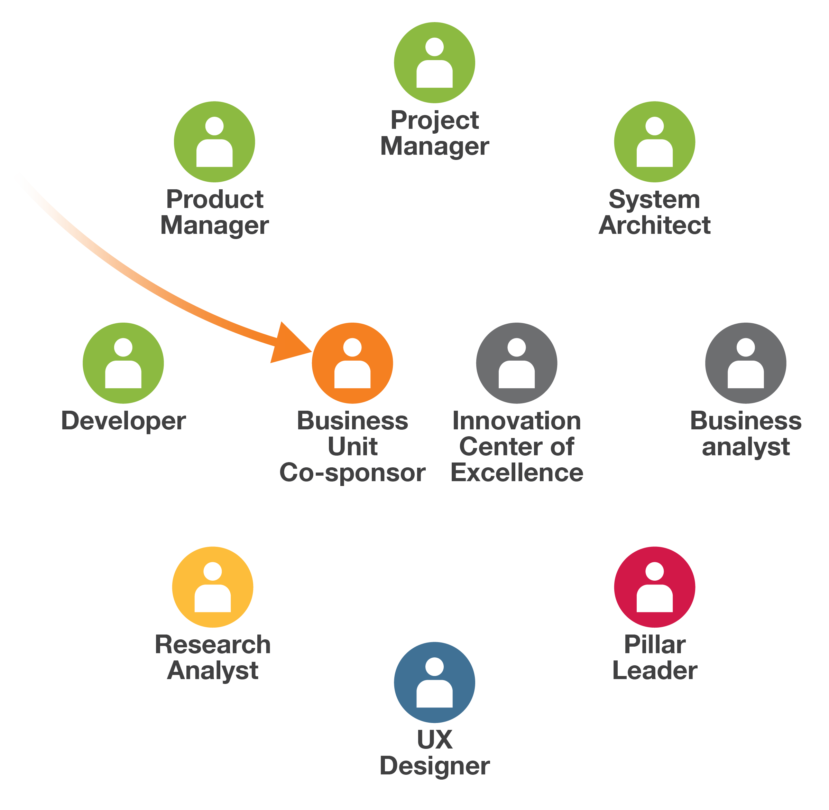
The innovation team has a matrixed structure for optimal collaboration
When a project enters the Innovation Studio, the project’s sponsor joins the innovation team. Additional team members are added, when needed.
Example organization key
Strategy & Innovation
Business Unit
Information Technology
Consumer Experience
Digital Solutions
Marketing Insights/Research

Slide 12
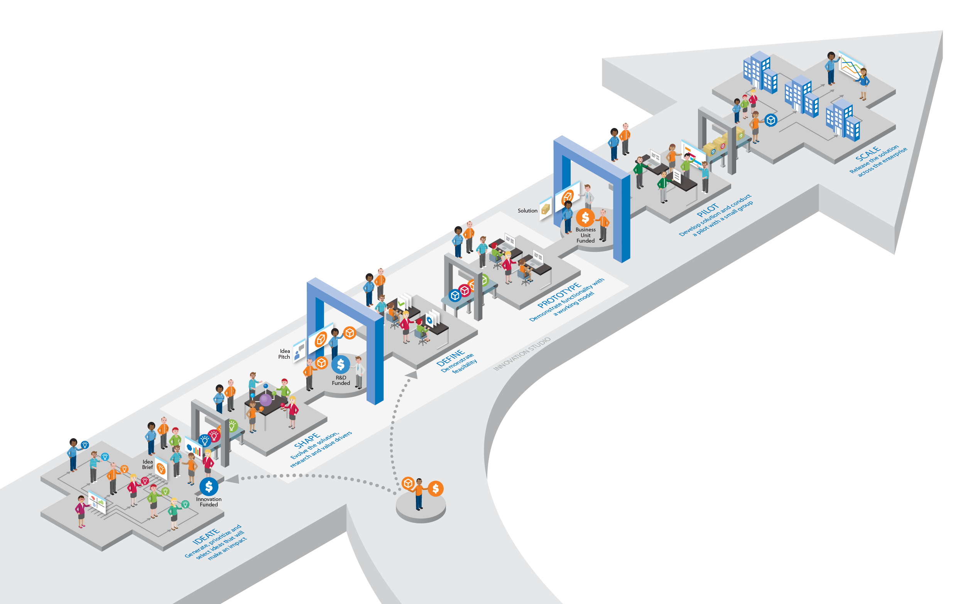

We use a flexible, agile innovation process
Our multi-phase process supports a wide range of ideas—from tech-based to business process improvement.

Slide 13
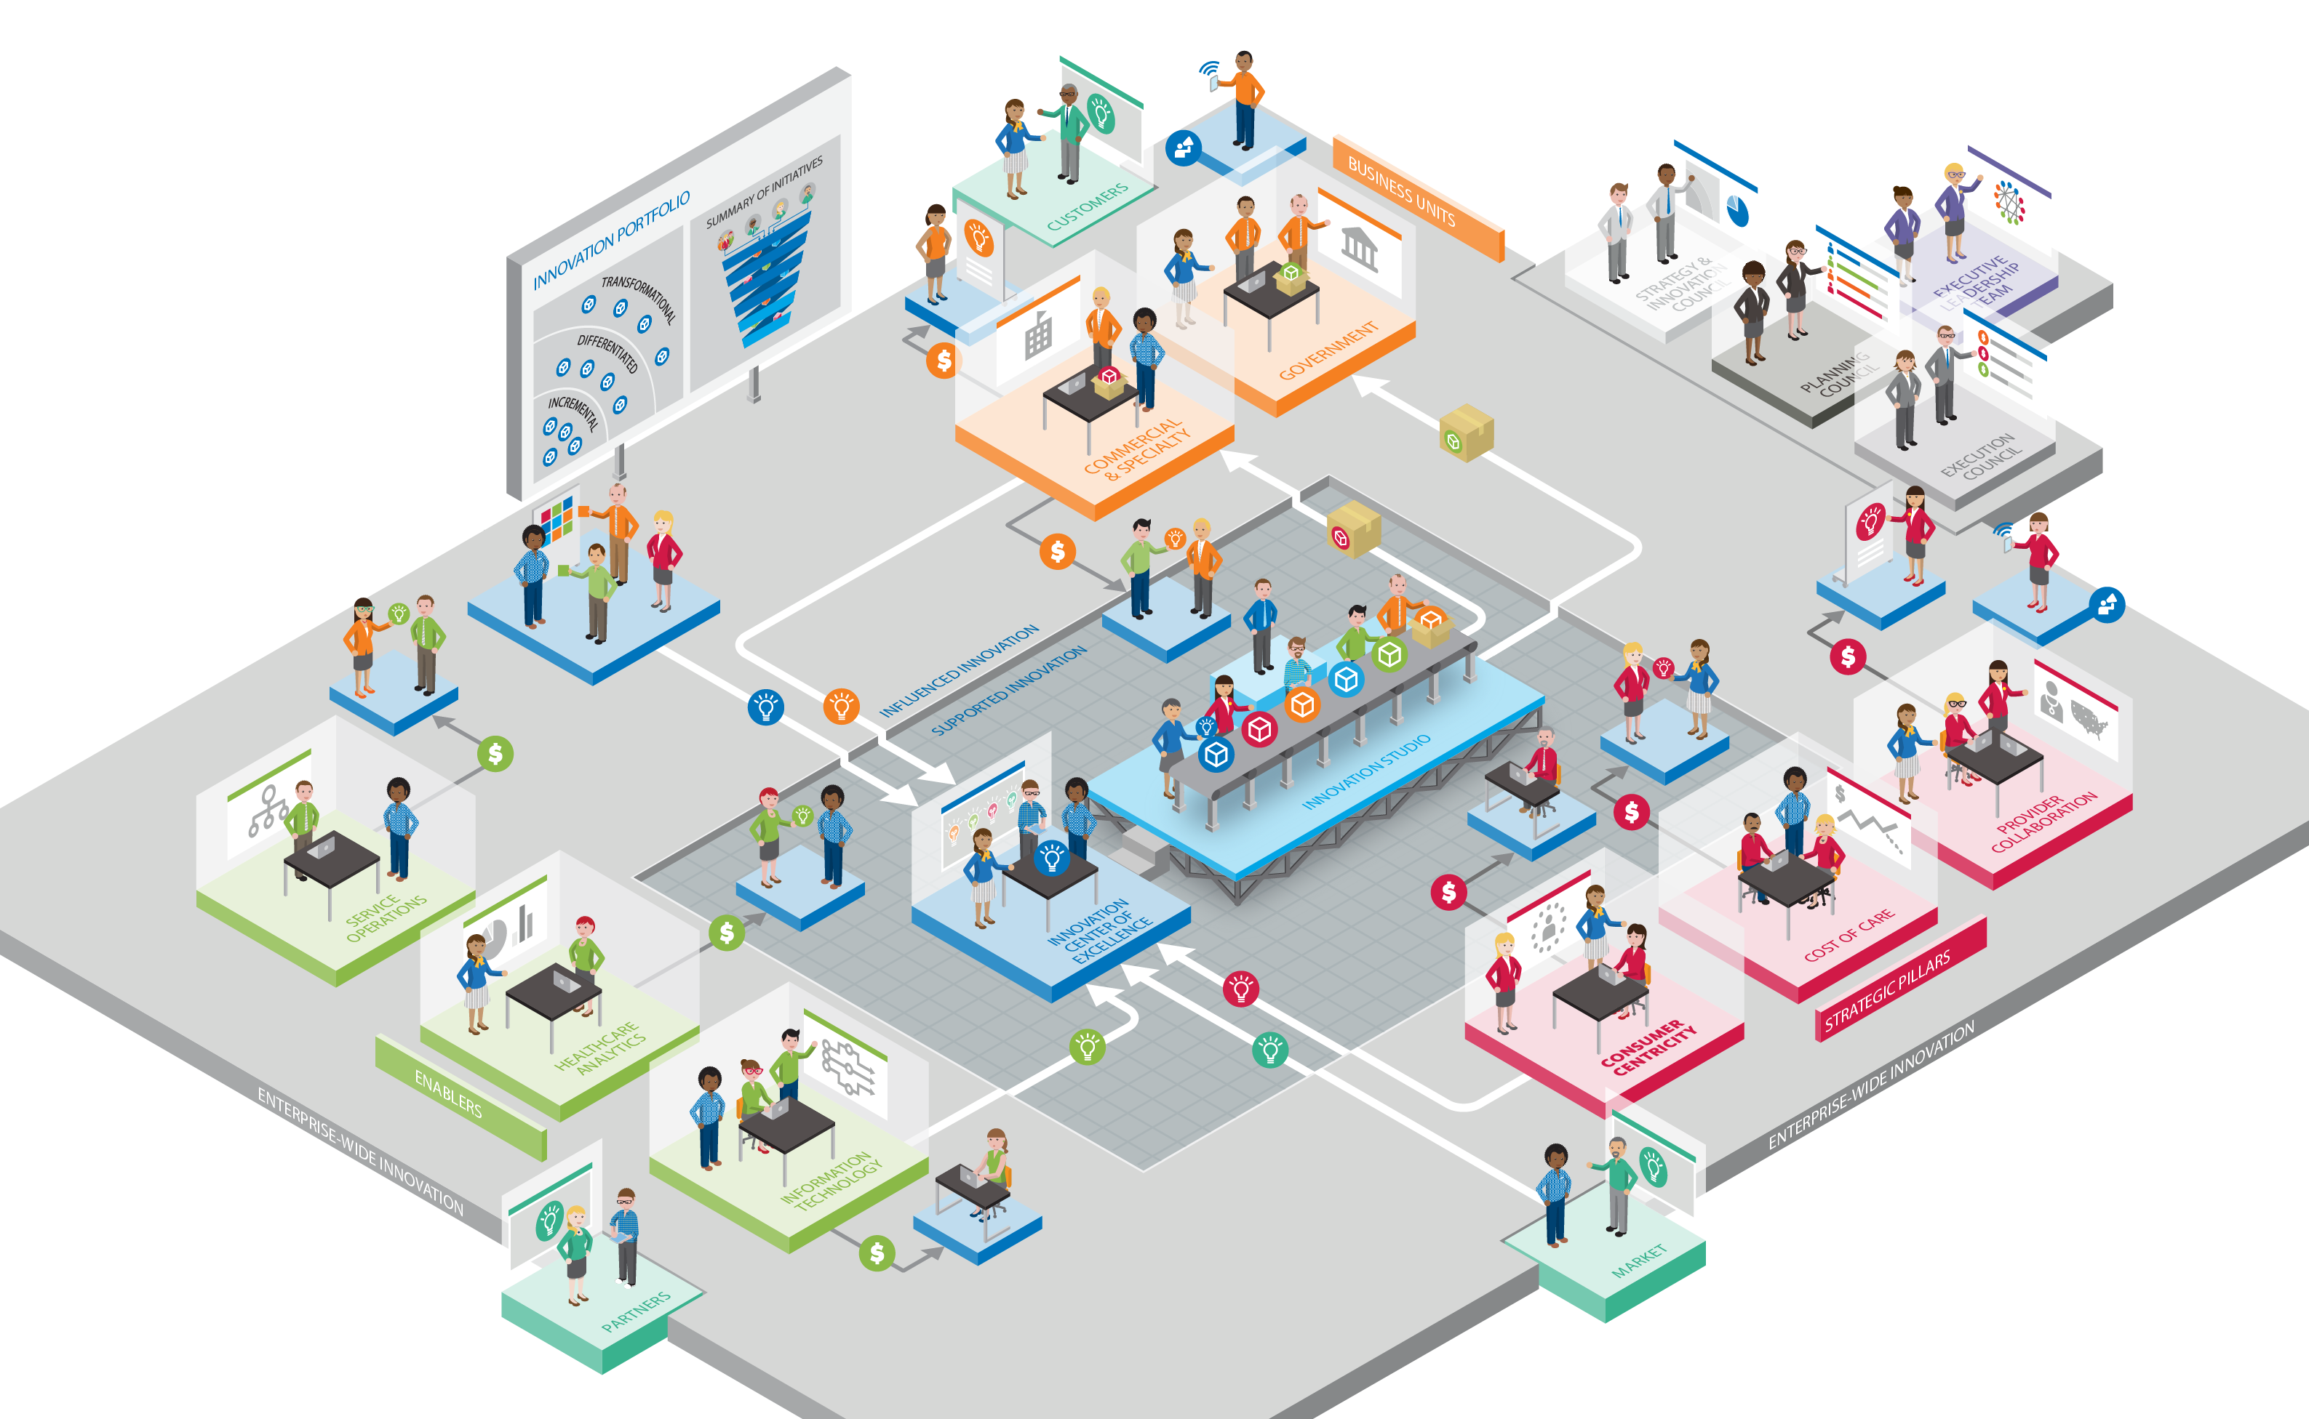
Our innovation process is part of a larger enterprise-wide innovation framework

Slide 14
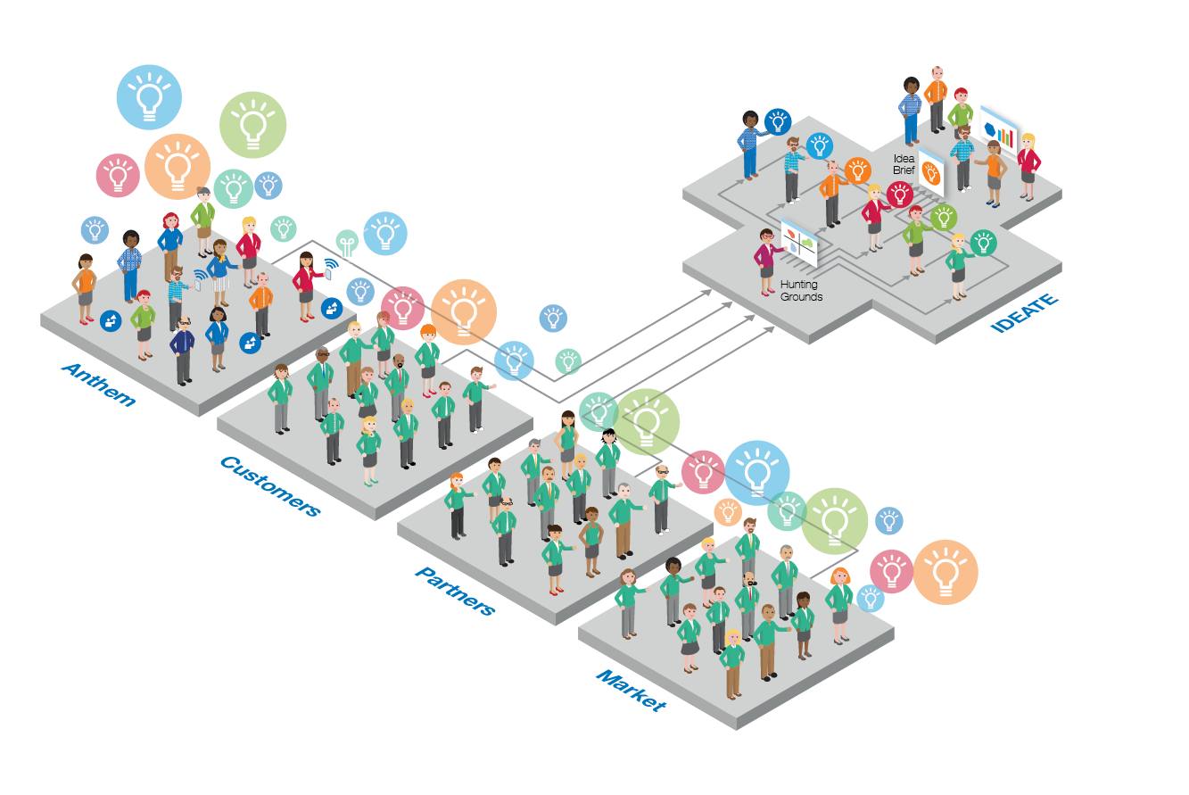
We gather innovative ideas both inside and outside of Anthem
Ideas come from proactive engagement with internal and external audiences through multiple approaches, such as SoapBox crowdsourcing, business engagement, customer advisory groups and vendor market scans.

Slide 15
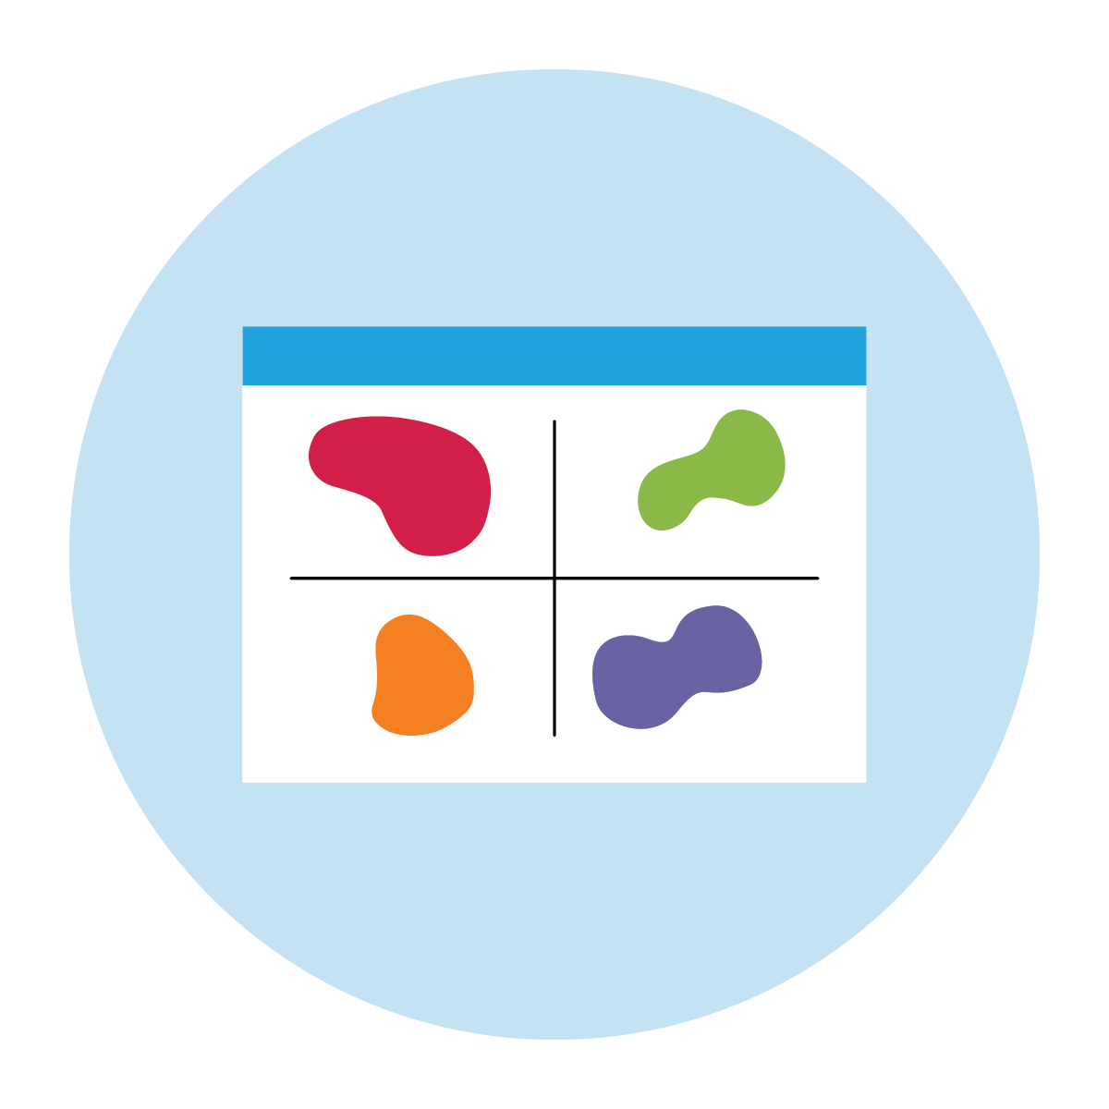



Once ideas are gathered, we use multiple criteria to select the most promising ideas
Aligns with
Hunting Grounds
Alignment with Strategic Pillars
Delivers Value to Anthem
Aligns with our Innovation Scale

Slide 16



Hunting grounds help us focus on select areas of the healthcare ecosystem
Remote Monitoring
Convenient Care
Payer Back Office 2.0
Using new technologies across care settings to monitor members with chronic conditions and facilitate near-real-time interventions.
Redirecting care from high cost settings to lower cost settings while leveraging technology and providing a better consumer experiences
Using emerging tech and other industry best practices to simplify payer administrative tasks.

Slide 17




Strategic Pillars make sure ideas align with enterprise strategy
Consumer Centricity
Strategic focus to improve consumers’ health, experiences and access to care.
Provider Collaboration
Strategic focus to improve how Anthem works with providers and provides network services.
Strategic Pillar Thought leaders and drivers of improvement in defined areas of the business. Includes Consumer Centricity, Provider Collaboration and Cost of Care.
Cost of Care
Strategic focus to lower the cost of quality care for members, including helping members identify how to get the right care at right time and place.

Slide 18



Value ensures that ideas will provide a return on investments
Revenue
Cost
Customer Satisfaction
Drives membership, increases up-sells, increases renewals, increases retention.
Reduces cost of care, improves health outcomes, reduces administrative cost.
Improves net promoter scores, increases retention, increases adoption.

Slide 19
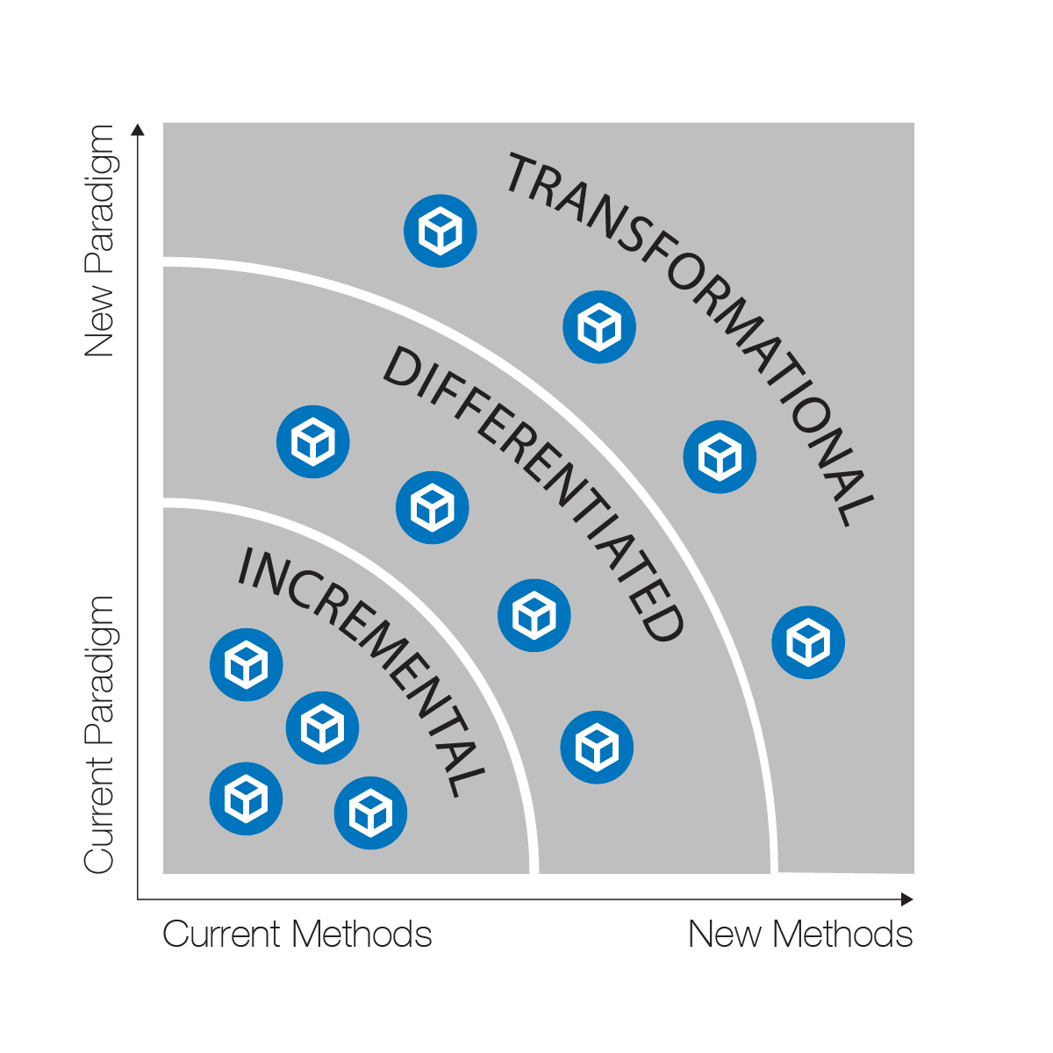
Innovation scale helps determine the need for innovation team engagement
Innovation ideas fit into 3 categories of investment and effort:
Incremental innovations improve Anthem’s core capabilities, or operating paradigm. Typically have lower risk, use current methods and take 1 to 2 years for financial return.
Differentiated innovations extend and enhance our core capabilities or paradigm and drive advantage in the market. Typically have a medium risk, use new-to-Anthem methods and take 2 to 4 years for financial return.
Transformational innovations identify new opportunities or new operating paradigms for the future. Typically have a higher risk, use new and emerging methods and take 4 or more years for financial return.

Slide 20
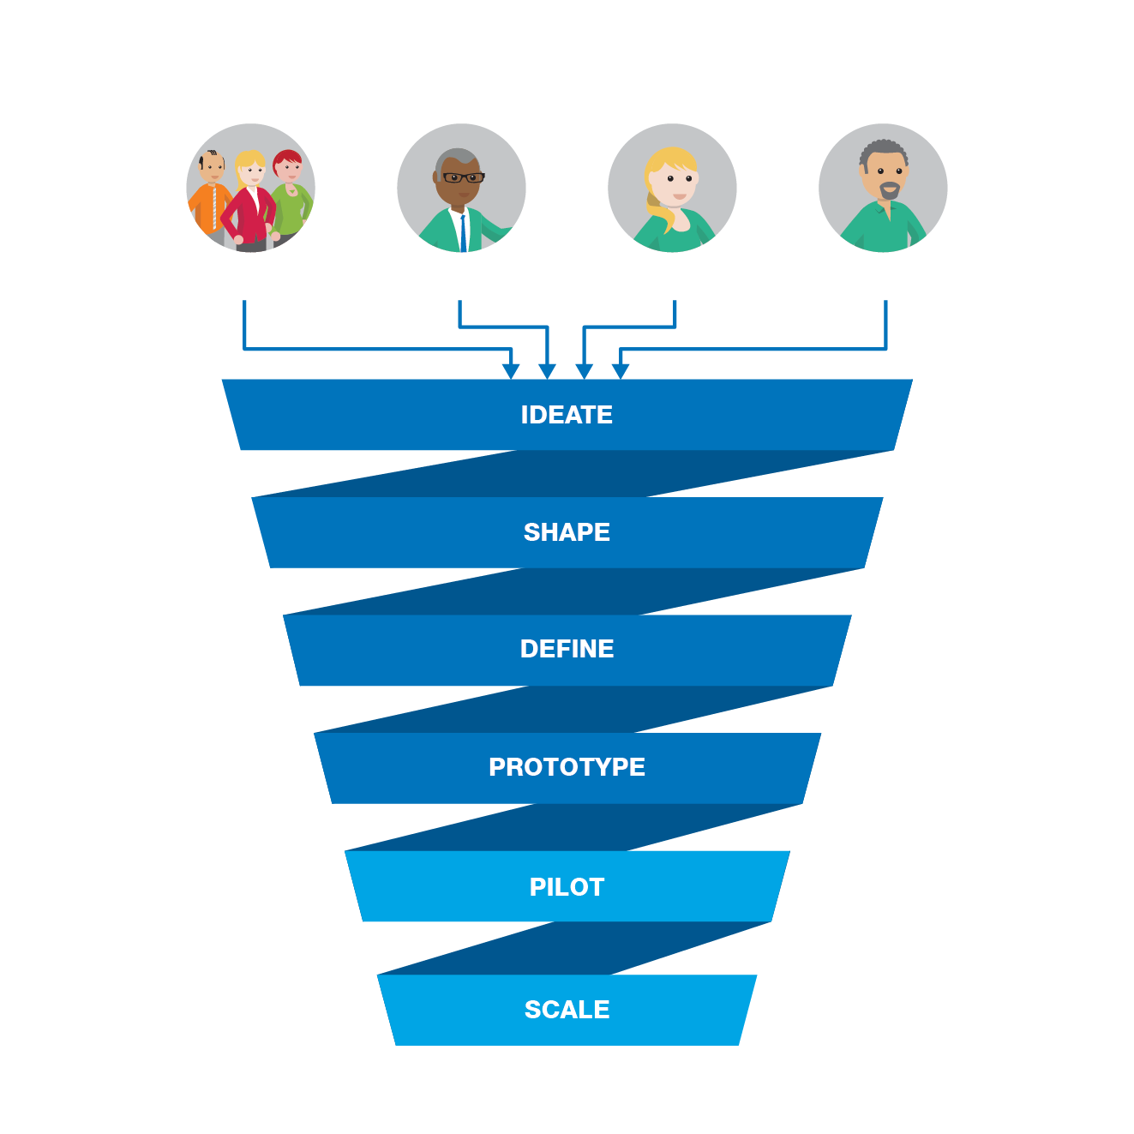






Internal and external ideas form a pipeline of innovation projects
Convenient Care
Payer Back Office 2.0
Remote Monitoring
Anthem
Customer
Partner
Market
Other
Anthem projects
Market projects
243 ideas
90 vendors
11
2
1
19
1
2
1
7
2
1
1
1
2

Slide 21
How you can get involved

Slide 22
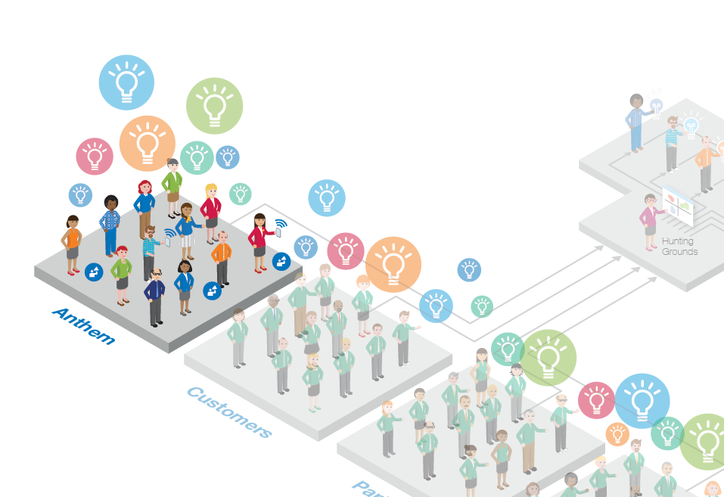
Help us gather ideas within Anthem

Slide 23




Participate in innovation activities
1
2
3
4
Innovation Consultation
Innovation domain leaders engage with business unit leaders
Identify business unit innovation strategy and plans
Soapbox Challenges
Business unit sponsored Soapbox Challenges solicit innovative ideas in desired areas
Anthem associates contribute innovative ideas
Innovation Workshops
Business unit teams come to the Innovation Studio to Ideate and Shape their priority innovation ideas
Top ideas from each business unit are advanced as candidates for Innovation Pitch Day
Innovation Pitch Days
Business unit sponsors present top innovative ideas to Innovation Council
Criteria are applied and top innovative ideas are approved and funded

Slide 24
We’re already using these approaches to engage leaders across Anthem
Information Technology
Service Operations
Pharmacy
Service Operations
Consumer Experience
750+ Anthem associates
so far have participated in innovation Soapbox Challenges
10 ideation workshops
With various business units and functions
Over 256 ideas generated with
16 currently in the funnel and over $1 billion in potential value identified

Slide 25
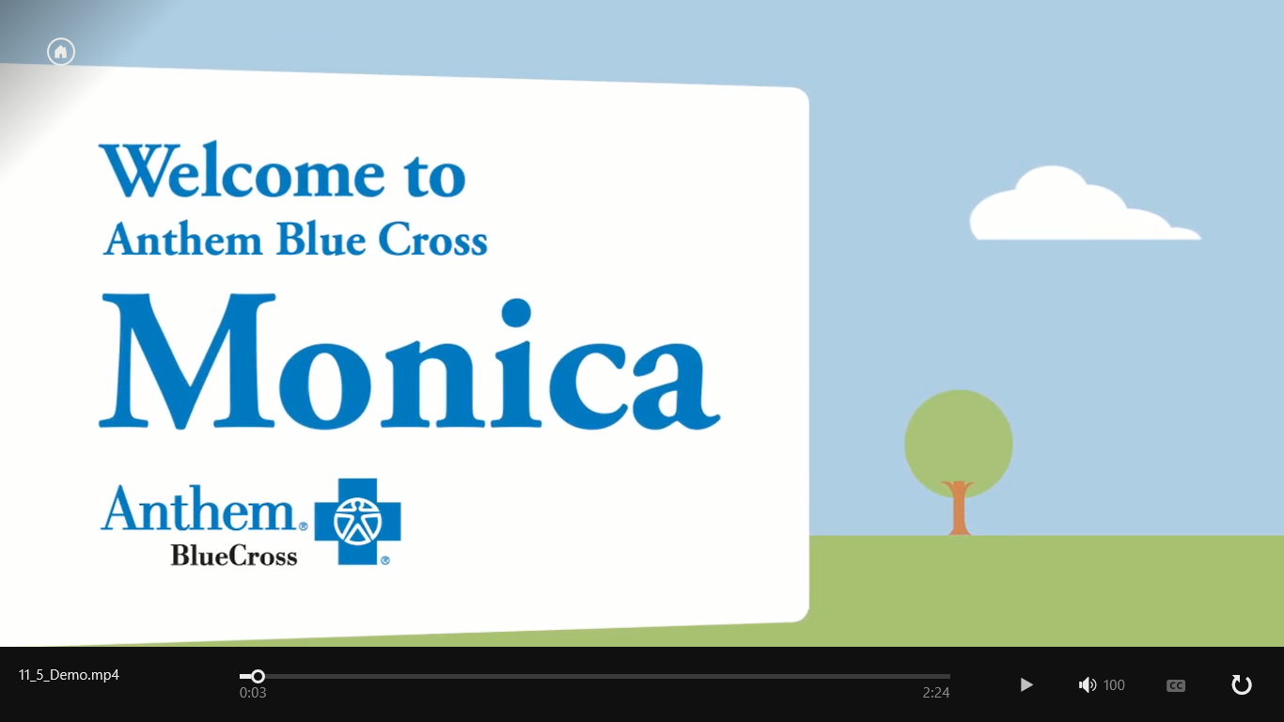

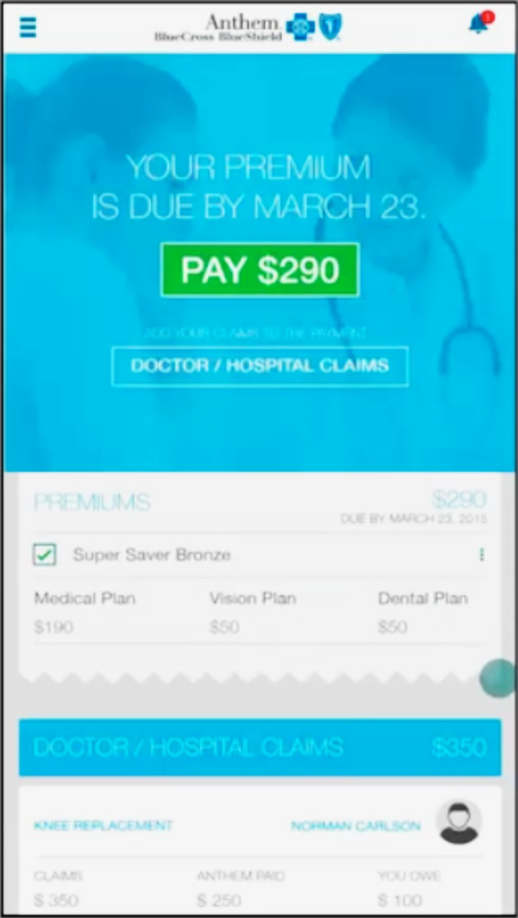
Some recent innovation examples
Welcome Video at Develop phase
Pay My Bills at Prototype phase
To view videos, select presentation mode and click on thumbnails
Password: AIS

